Slide 1


Hide IN PLAIN Site (HIPS) and Key Hide in Plain Site (KHIPS)
The ideas and their applications

Slide 2
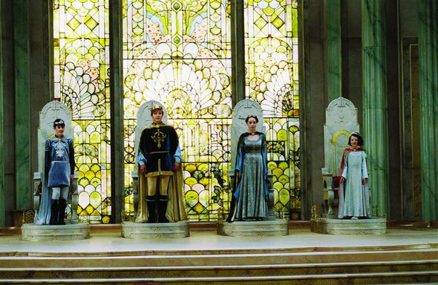
Imagine
A magical land of adventure and riches…

Slide 3

Everyone wants it

Slide 4
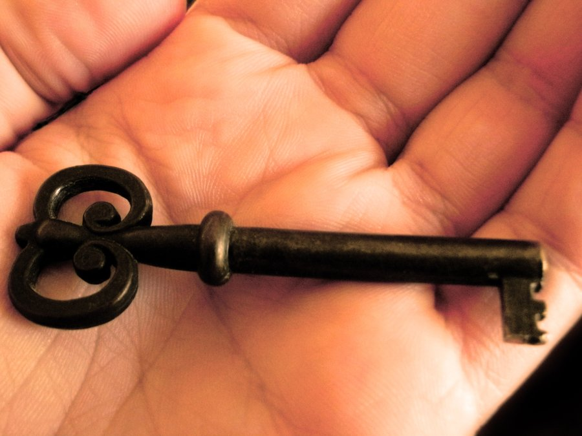
So you make a key to secure it
Only those with the key can enter the magic land

Slide 5
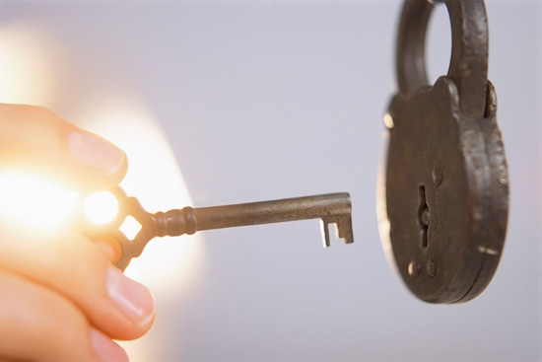
The old way
If the key fits, it turns and you are in
One unique key opens one unique room

Slide 6
It turns-you win
It is obvious when it works because there is only 1 right answer

Slide 7
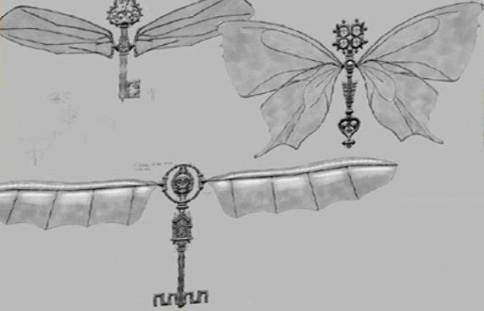
The new way-HIPS
Many keys fit but instead of opening Narnia

Slide 8

You get something magical

Slide 9
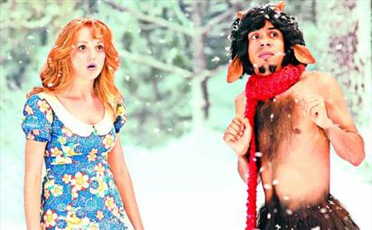
But not quite right
Yes, this is Narnia! Why do you ask?

Slide 10
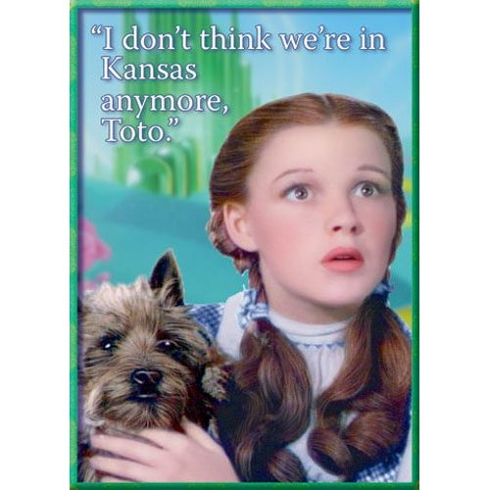
So unless you know the answer
You don’t know that you are in the wrong land

Slide 11

So…
Imagine a key that secures a room
Many keys turn the lock
However, if you don’t get the right key you open another room
But you don’t know its another room
That is HIPS

Slide 12

The idea more formally
Tenets of HIPS methodology
Encrypted data should look like real data
Must have key to unencrypt
Key is ambiguous
Key must not exist with data and vice versa
Each row must do one of the following:
Encrypt itself
Point to row without the correct value

Slide 13

Let’s go over each 1
Which is the HIPS row, real row, and Public/Private key row?

Slide 14
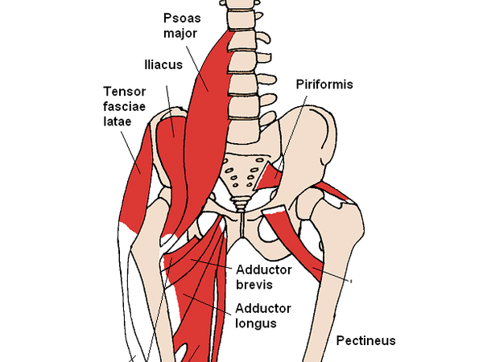
HIPS TECHNIQUE
Use other columns to encrypt data in row
Final product must look like real data
SSN
Date of birth

Slide 15

Must have key
If you don’t have the right key
You end up with wrong answer but you won’t know it
It looks like a real answer

Slide 16

Key is ambiguous
Dec25=
Oct31=
12/25=10/31
What number is this?
1001
Could also be 9 (Binary)
Also could use hex and various other base systems

Slide 17

Key and data
Got to keep ‘em separated
Hacker can get database and not have data
Database cannot show data is encrypted
This is underappreciated point

Slide 18
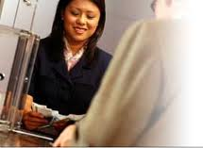
The LINDA PROBLEM
Linda is 31 years old, single, outspoken, and very bright. She majored in philosophy. As a student, she was deeply concerned with issues of discrimination and social justice, and also participated in anti-nuclear demonstrations.
Which is more probable?
Linda is a bank teller.
Linda is a bank teller and is active in the feminist movement.

Slide 19
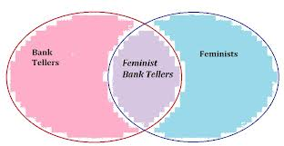
Conjunction fallacy
HIPS ideas create a lower probability by adding systems needed for compromise
Every “And” added to story makes it less probable

Slide 20
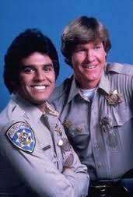
KHIPS
Just extends the idea of HIPS
Servers
Database
Application
Key
Authentication
Each system is missing a piece of the puzzle

Slide 21

Inner encryption
Row of SSN and Date of Birth
Date of Birth encypts SSN and SSN encrypts Date of Birth
Quick important point-what if I know my answer?

Slide 22

SIMPLE EXAMPLE
Birth date is 1/1/1990, SSN is 365-12-1630
Key is 1/5/1991

Slide 23

Doing the math
Difference from key is 370 days
Add 370 to 365-12-1630 =365-12-1700
Add 365 days to 1/5/1991=1/5/1992
Even if you know answer and initial values
Don’t know how it was derived

Slide 24

City State ZIP
Can’t just switch city state and zip
So have a lookup to a table of city, states and zips
But the pointer needs a key to get to correct data

Slide 25

It has been tested
Gave multiple programmers a chance to encrypt for prize
No one was able to beat it with all the answers at hand
Not real hacker fest but encryption was trivial

Slide 26
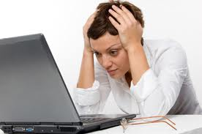
Common problems
What’s wrong with current encyption?
Reporting on data from database
Key in database=> get database get key
Key in application => can’t report on data
HIPS solves this common problem

Slide 27

COMMERICAL IDEAS
Important long term point
Quantum computing will break current encryption schemes
Will not break HIPS or KHIPS

Slide 28
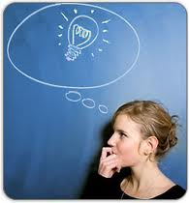
Sell Access to idea
Similar to the “rounded buttons” patent by Apple
Just license HIPS as way to better secure data

Slide 29

U of A Servers
U of A sells Key server
Similar to Key servers like https
U of A as public data store
Key is separate
Stealing data is not gaining access
Holding AZ’s public data securely

Slide 30
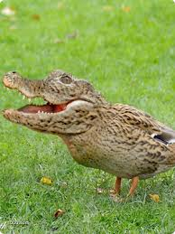
Weird points
Data can be constantly re-encrypted with key server
Adds timing, more conjunction, lower probability to hack
Data server can have encrypted and non-encrypted
Added service makes more secure un-secure data

Slide 31
So what can we do?

